Slide 1
ITS HR/PAYROLL
Session 49 Payroll Dependency on HR Data
Presented by Allie de Nysschen

Slide 2
ITS is an Integrated system what is an
Integrated system
Payroll dependency on HR and Other data
How to complete your Payroll on time
How to complete your IRP5 Submission on time

Slide 3
Table of contents
What is an Integrated system?
Payroll dependency on HR and Other data
How to complete your Payroll on time?
How to complete your IRP5 Submission on time?

Slide 4
What is an Integrated System?

Slide 5
What is an Integrated system
An "integrated system" refers to a system where:
multiple different components or sub-systems are combined and work together seamlessly as a single functioning unit,
allowing for smooth data flow and
coordinated operations across various functions within an organization,
often achieved through software integration and connecting different hardware elements;
essentially, it's a unified system where different parts can access and share information easily.

Slide 6
What is an Integrated system
Key points about integrated systems:
Combined functionality: Different systems or applications are linked to operate as one, eliminating the need for manual data entry between separate systems.
Improved efficiency: By streamlining data access and automating workflows, integrated systems can significantly increase productivity and reduce errors.
Centralized data access: Users can access information from various sources within a single platform, promoting better decision-making eliminating data duplication.

Slide 7
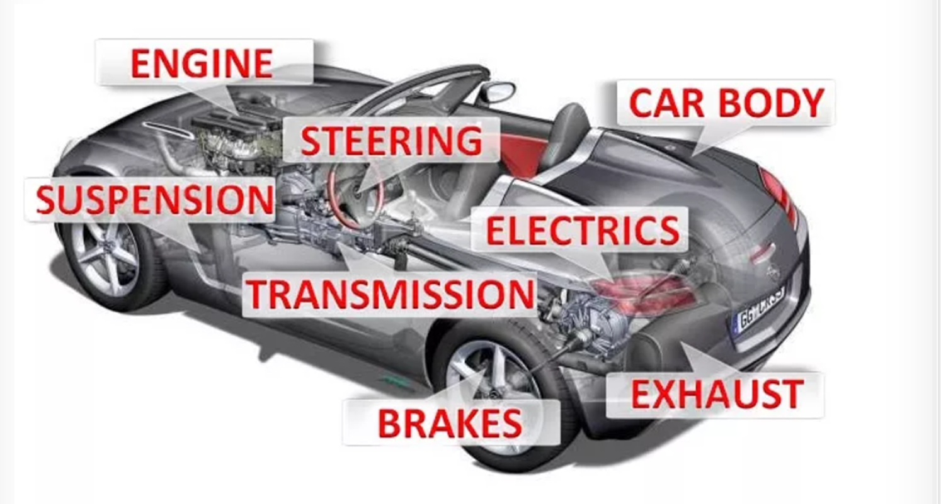
What is an Integrated system

Slide 8
Its Is An Integrated System

Slide 9
Its Is An Integrated System
This means that the ITS system is one integrated system with multiple sub systems like HR, Payroll, e-Recruitment, Probation, Overtime Management, secondary Appointments, Claims etc.
Each of these sub systems is further broken down into function or units functioning as one system.
Data duplication does not exist i.e. Biographical details is maintained in one place but used in all the sub systems. This implies there is one true data source when this changes it changes in one place and all sub systems only use the one true data source.
What is the bottom line? HR subsystems capture or maintain data that is used by other subsystems like payroll, today I will show you how HR data impacts on the Payroll process.

Slide 10
Payroll dependency on HR and Other data

Slide 11
Payroll dependencies on HR and Other Data

Slide 12
Payroll dependencies on HR and Other Data
As can be seen from the previous slide the following areas or sub systems impact on the payroll process
Personnel Biographical data {BPOP-1}
Service Records {PBOP-2}
Funds {PAOP-4 or 5}
Dependants {PBOP-7}

Slide 13
Payroll dependencies on HR and Other Data PBOP-1 – Biographical data for a new Appointment
Data fields that have an impact
Data Field PBOP-1 | Impact | Fatal Error | Warning Error | Calculation Impact
ID Number | This will lead to a fatal error when running a payroll calculation if the Nature of person field = A and this field or the Passport field is null. | X
Birth Date | This will be compared to the first 6 digits of the ID number if invalid it will be a fatal error |  | x
Gender | This will be used for Communication purposes

Slide 14
Payroll dependencies on HR and Other Data PBOP-1 – Biographical data for a new Appointment
Data fields that have an impact
Data Field PBOP-1 | Impact | Fatal Error | Warning Error | Calculation Impact
Appointment Date | This will determine the following: The period from which Tax liability will be calculated If a specific income can be prorated the start date will determine if a full amount is calculated i.e. like Bonus This will also determine Leave credit days if the leave type is prorated. The Start date Must be < resignation Date | X |  | X X X

Slide 15
Payroll dependencies on HR and Other Data PBOP-1 – Biographical data for a new Appointment
Data fields that have an impact
Data Field PBOP-1 | Impact | Fatal Error | Warning Error | Calculation Impact
Post Code | The Post code will determine the GLA (Cost Centre and account) to be used for Earnings ED codes for which the GLA was not specified in which case the post GLA will be used. If the GLA (Cost Centre and Account) combination is invalid it will post to the suspense account |  | X

Slide 16
Payroll dependencies on HR and Other Data PBOP-1 – Biographical data for a new Appointment
Data fields that have an impact
Data Field PBOP-1 | Impact | Fatal Error | Warning Error | Calculation Impact
Resignation Date | This will determine the following: The period Up to which Tax liability will be calculated If a specific income can be calculated on a prorated basis the end date will determine if a partial amount is calculated i.e. like Bonus This will also determine Leave credit days if the leave type is prorated. The Resignation date must be > start date or null | X |  | X X X
Continuous Start date | This will have an effect of calculating long service awards

Slide 17
Payroll dependencies on HR and Other Data PBOP-1 – Biographical data for a new Appointment
Data fields that have an impact
Data Field PBOP-1 | Impact | Fatal Error | Warning Error | Calculation Impact
Appointment Type | This will have the following impact : a direct impact on the remuneration calculated as specific ED codes are linked to the Appointment type It will also determine the leave package that defaults on appointment which determine the leave benefits of a person |  |  | X X
Rank | Depending on how Salary scales are setup this may result in fatal errors when running the payroll process if the incorrect rank is linked to the person if it does not align with his salary scale | X

Slide 18
Payroll dependencies on HR and Other Data PBOP-1 – Biographical data for a new Appointment
Data fields that have an impact
Data Field PBOP-1 | Impact | Fatal Error | Warning Error | Calculation Impact
Leave Package | This determines the leave benefits the person will receive and has a direct impact on the leave liability. |  |  | X
Stats Category | This has a direct impact on Hemis submission data
Occupational Classification | This has a direct impact on the SETA reporting
Campus code | This has an impact on the SETA reporting
Supervisor | This will be used for leave approval and other Routing approval processes

Slide 19
Payroll dependencies on HR and Other Data PBOP-1 – Biographical data for a new Appointment
Data fields that have an impact
Data Field PBOP-1 | Impact | Fatal Error | Warning Error | Calculation Impact
Citizen Resident Status | This is used in the standard Equity, EEA2 and EEA4 reporting.
Foreign Tax Employee | This will result in the foreign tax codes and descriptions being generated for the person when an IRP5 is generated.
Income Tax Number | This will result in a Fatal salary CALC error as well as fatal error when generating IRP5’s if it does not exist. | X
Marital Status | If an invalid option is entered here it will result in a fatal error when a salary calculation is done. | X

Slide 20
Payroll dependencies on HR and Other Data PBOP-1 – Biographical data for a new Appointment
Data fields that have an impact
Data Field PBOP-1 | Impact | Fatal Error | Warning Error | Calculation Impact
Nature of Person | This determines if an ID number or Passport is required and will be a fatal error if it does not exist and is required when doing a salary calculation or an IRP5 calculation. | X
UIF Employment Status | This determines if a person must pay UIF, if the incorrect status is selected here vs the appointment type selected when running a salary calculation it will result in a fatal error. | X |  | X
UIF Reason code for Non- Contribution | This may be required if there is a valid reason when the person should contribute to UID and is not. Reason code 01 indicates the person is contributing. | X

Slide 21
Payroll dependencies on HR and Other Data PBOP-1 – Biographical data for a new Appointment
Data fields that have an impact
Data Field PBOP-1 | Impact | Fatal Error | Warning Error | Calculation Impact
Income Tax Number | This will result in a Fatal salary CALC error as well as fatal error when generating IRP5’s if it does not exist. | X
Ethnic Group | This is used for Equity Reporting as well as EEA2 and EEA4 reporting
SARS Addresses | (Work Address, Home Address and Postal Address) This will result is An error | X

Slide 22
Payroll dependencies on HR and Other Data PBOP-1 – Biographical data for a new Appointment
Data fields that have an impact
Data Field PBOP-1 | Impact | Fatal Error | Warning Error | Calculation Impact
Pension Fund code | This is where the fund code for pension is linked to a person. It is important to link the person to the correct pension fund and appointment type. If the incorrect combination is selected and the pension ed code using the fund code is not linked to the Appointment type no pension will be calculated |  |  | X
Fix Tax Rate | This indicator only indicates that fixed 25% tax must be deducted, however the actual appointment type the person is linked to will calculate tax based on the ED code linked to the app type – Tax tables or 25% fixed tax. | X

Slide 23
Payroll dependencies on HR and Other Data PBOP-1 – Biographical data for a new Appointment
Data fields that have an impact
Data Field PBOP-1 | Impact | Fatal Error | Warning Error | Calculation Impact
Provident fund code | The same rule applies for medical aid |  |  | X
Medical Aid | The same rule applies for medical aid |  |  | X
Group Life | The same rule applies for Group Life |  |  | X

Slide 24
Payroll dependencies on HR and Other Data How do You prevent such situation
There are a few reports that can be run regularly and timeously to ensure that by the time you start with your payroll processing elementary data issues are correct which may have a big impact on your salary calculations and salary payment process ensuring the correct salary is paid on time into the correct bank accounts.
PBOP-1 – Biographical Detail
PBOP-2 – Service Records
PAOP-4&5 - Funds
PBOP-7 – Dependants
PBOP-12 – SARS Addresses

Slide 25
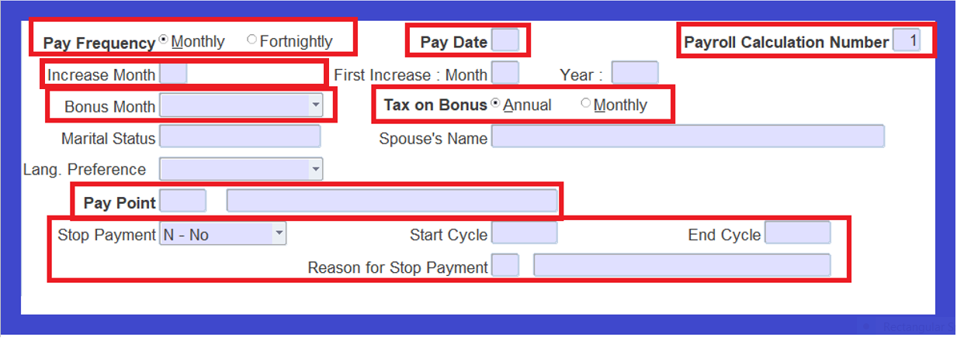
Payroll dependencies on HR and Other Data How does the Critical Payroll data impact on the Payroll system – FPRI-1 Tab 1 Page2

Slide 26
How to complete your Payroll on time?

Slide 27
Payroll dependencies on HR and Other Data What is the Problem?

Slide 28
How to complete Your Payroll on Time?

Slide 29
How to complete Your Payroll on Time?
Before the HR Cutt off date every month run the following Validation Reports and request HR and or Payroll to act timeously on correcting data errors.
Validate Payroll Data {FPRIV-1}
Validation Of Salary-Related Data
Fatal Errors:
Invalid marital status
Invalid increase month
Invalid account type for payment type bank or tape transfer
No bank account or branch code for bank or tape transfer
Invalid bonus month
Tax-on-bonus indicator is equal to “M” for bonus month equal to 0 or null
Invalid calculation number or pay date

Slide 30
How to complete Your Payroll on Time?
Before the HR Cutt off date every month run the following
Validate Payroll Data {FPRIV-1}
Validation Of Salary-Related Data
Fatal Errors:
No notch record in the Salary Notch Record table. (A notch value of 0 should exist for Paid By Claim employees.)
Warnings:
Invalid tax-on-bonus indicator
Invalid payment type
“C” Records without “Q” records. (Payroll calculations without cheques.)

Slide 31
How to complete Your Payroll on Time?
Before the HR Cutt off date every month run the following
Validate Payroll Data {FPRIV-1}
2. Validation Of Fund Membership Records
Fatal Error
Duplicate end dates

Slide 32
How to complete Your Payroll on Time?
Before the HR Cutt off date every month run the following
Validate Payroll Data {FPRIV-1}
3. Validation Of Service Records
Fatal Errors:
No service records at all
Duplicate start dates
Duplicate end dates
Start date on record bigger than end date
End date of record is bigger than start date of next
No record with start date = appointment date
No record with end date = resignation date
Record has no end date, but resignation date exists

Slide 33
How to complete Your Payroll on Time?
Before the HR Cutt off date every month run the following
Validate Payroll Data {FPRIV-1}
3. Validation Of Service Records
Fatal Errors:
Record with no end date is followed by record with end date
Warnings:
Post, Rank or Appointment code or name missing

Slide 34
How to complete Your Payroll on Time?
Before the HR Cutt off date every month run the following
Salary Transactions After Resignation {FPRIV-2}
If a user has introduced late transactions into the system by artificially extending a person's service period and then
subsequently re-setting the resignation date to the correct value, both the IRP5 and STATS 4.07 information will be incorrect for
such a person.
This report highlights the existence of such salary transactions. The user must then correct the situation by doing the required
late rollbacks and calculations.
Individual E/D and Stop Payments {FPRIV-3}
A Stop Payment indicator can be set to (Y)es for an employee on Fixed Salary Detail {FPRI-1}, whilst there may have been
Individual E/D's {FPRI-2} that have been advised for the period during which the Stop Payment was in effect. The danger
however, then exists that these E/D's will “fall through the cracks” and never be processed by the salary calculation programs.
This Jasper report highlights such cases and allows the salaries department to take the appropriate action.

Slide 35
How to complete Your Payroll on Time?
Before the HR Cutt off date every month run the following
Validate ACB Credits {FPRIV-4}
The user is given the opportunity of validating the information entered in {FPRI-2b2}. This report will be used to validate that
the banking detail linked to the transaction is correct
The report consists of two sections: 1. Those transactions found in {FPRI-2b1}, but not in {FPRI-2b2}. 2. Those transactions found in {FPRI-2b2}, but not in {FPRI-2b1}.
Validate Bonus Month and ID Number {FPRIV-5}
The user is given the opportunity of validating the information regarding bonus month, birth date and the first six characters of
the ID number, entered in {PBOP-1} and {FPRM-6}

Slide 36
How to complete Your Payroll on Time?
Before the HR Cutt off date every month run the following
Validate ACB Tape Information {FPRIV-6}
The user is given the opportunity of validating the ACB Tape information before creating the tape file. This will specifically look
at valid Pay Dates
R.A / Arrears Pension Contributions {FPRIV-7} This report highlights employees who are approaching, or have exceeded, the allowable tax-deductible limits for contributions towards Retirement Annuities and / or buy-back of pension.
Validate GLA's on Payroll Data {FPRIV-8}
This option provides the facility to validate General Ledger Allocations (GLAs), as setup for the Salary Calculation against the
valid values for the Financial Year (as recorded in Maintain GL Allocations {FCSO-6}) before executing a salary calculation run.

Slide 37
How to complete Your Payroll on Time?
Before the HR Cutt off date every month run the following
Validate Retirement Fund Members {FPRIV-9}
The Menu Option validates the Retirement Fund Component, Retirement Fund Category, Retirement Fund Factor and
Retirement Fund Start Date detail, linked to the Retirement Fund Membership detail of personnel on either {PAOP-10} or
{FPRI-15}. It is the same validation that is run when exiting these two Menu Options.
The following validation of data is done and a detailed validation report is generated:
(i) Retirement Fund Component field must have a value for all records. If no value exists, a validation error is reported.
(ii) If Retirement Fund Component is :
•‘DC’ (Defined Contribution) then the Fund Factor field must be null else an error is reported
•‘DB’ (Defined Benefit) or ‘DC & DB’ (combination of Defined Contribution & Defined Benefit) then the Fund Factor field
must have a value, else an error is reported.
(iii) If a record exists on either {PAOP-4} or {PAOP-5} but no record exists for the employee on this menu option, an error is
reported.
(iv) If multiple records exist for an employee with the same Fund Code and overlapping Retirement Fund Start and Retirement
Fund End Dates, an error is reported.
(iv) If Date Joined {PAOP-4} or {PAOP-5} differs from Fund Join Date {PAOP-10} an error is reported.

Slide 38
How to complete Your Payroll on Time?
Before the HR Cutt off date every month run the following
Validate Duplicate ID, Passport, Income Tax and Bank Account
Numbers {FPRIV-10}
This program can be run to identify duplicate ID Numbers, Passport Numbers, Income Tax numbers and Bank Account Number
that have been defined for /linked to more than one Personnel Number.
Validate Notches {FPRIV-21}
This option provides the facility to validate salary notches. This is use full when the On-Line Notch Validation in the Validation
Control {FPRM-8} is set to (N)o.
Unposted AR/SD Salary Transactions {FPRIV-22}
This option provides the facility to create a report of all salary transactions that have not yet copied back to the AR sub-system
(staff loans) or the SD sub-system (student debtors repayments). A Final posting cannot be made until all transactions have
been copied back to AR/SD. This report has been built into the AR Posting program {FGLP-4} and the student debtor posting
program {FGLP-2}. The posting process is stopped if transactions exist that have not been copied back to the sub-systems.

Slide 39
How to complete your IRP5 Submission on time?

Slide 40
How to complete Your IRP5 Submission on time?
The biggest issue when IRP5’s are generated is that the number of validations errors are overwhelming
Validate Payroll Transactions {FPRT-21}
Type of Validations done on a monthly basis
Validate Primary Addresses
Validate Primary Telephone Numbers and e-mail Address
Validate ID No, DOB, Passport & Country of Issue, Biographical
Validate Income Tax Reference Number
Validate Bank Account Requirements
Validate Tax Directives
Validate Change in Nature of Person and Invalid N.o.P
Validate retirement Funding Details
Validate Travel allowance
Non-Taxable IRP5 Codes which were Taxed and Taxable IRP5 Codes which were not Taxed
List Invalid IRP5 Boxes
Validate Negative Amounts on IRP5 Boxes

Slide 41
How to complete Your IRP5 Submission on time?
The biggest issue when IRP5’s are generated is that the number of validations errors are overwhelming
Validate Payroll Transactions {FPRT-21}
Type of Validations done on a monthly basis
Validate Tax on Retirement Lump Sum/Severance Benefits (4115)
Validate Medical Tax Credit (4116)
Validate Fixed Tax Rate & Tax Calculated on Tables/Advised Tax
Validate if All salary Transactions have Corresponding S/R
List of Transaction without Posting Dates
Validate Break in Service Record for Period Cycle

